Slide 1
Does Evolocumab Use in Europe Match the 2019 ESC/EAS Lipid Guidelines?
Results from the HEYMANS Study
SC-AT-AMG145-01086 Apr2025

Slide 2
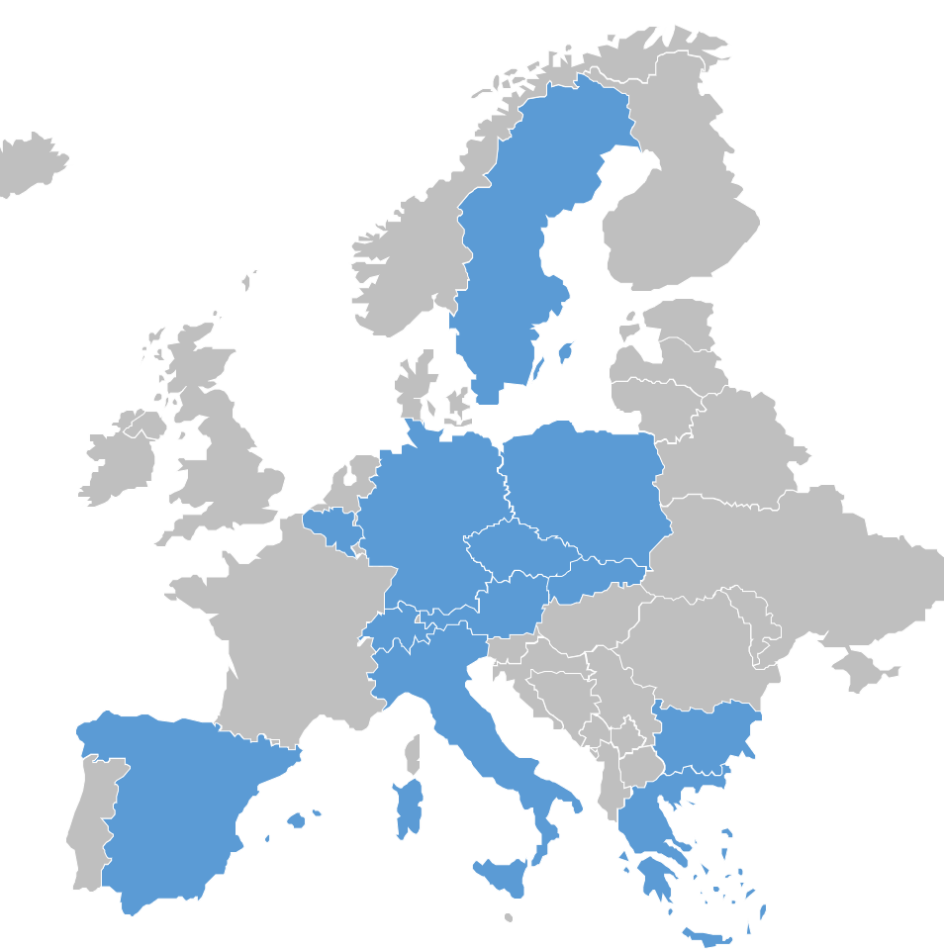
Does evolocumab use in Europe match the 2019 ESC/EAS lipid guidelines?
Results from the HEYMANS study
K K Ray¹, E Bruckert², B Van Hout³, M Feudjo Tepie⁴, I Bridges⁴, M Sibartie⁶
¹Imperial College, London, UK; ²Hôpital Pitié Salpêtrière, Paris, France; ³Sheffield University, UK; ⁴Amgen UK Ltd, Uxbridge, UK; ⁵Amgen (Europe) GmbH, Rotkreuz, Switzerland
This study was funded by Amgen (Europe) GmbH, C Desborough of Amgen UK provided medical writing support for this presentation.

Slide 3
Characteristics of patients initiating evolocumab and treatment patterns across 12 European countries: the HEYMANS* study
Observational study in adults ≥ 18 years† who received evolocumab as part of routine clinical management, and within local reimbursement criteria, after 1 August 2015 (in Austria, Belgium, Bulgaria, Czech Republic, Germany, Greece, Italy, Portugal‡, Slovakia, Spain, Sweden and Switzerland)
  Patients enrolled in a PCSK9i interventional study, or who received commercially available PCSK9i within 12 weeks before evolocumab initiation, were excluded
  Primary outcome: clinical characteristics of patients at evolocumab initiation
  Interim analysis reported here included data from 1896 patients across 11 countries‡ and follow-up until October 2019
Evolocumab initiation as part of routine clinical management (baseline) after 1 August 2015
Data collected for up to 26 weeks before evolocumab initiation
Data collected for up to 30 months after evolocumab initiation
Baseline period
Follow-up period§
*CHaractEristics of hYperlipidaeMic pAtieNts at initiation of evolocumab and treatment patterns. †Providing informed consent, if applicable locally. ‡Portugal had not enrolled any patients at the time of this interim analysis. §Where enrolment occurred after evolocumab initiation, follow-up data between initiation and enrolment was retrospective; patients were followed for up to 30 months irrespective of whether they continued to receive evolocumab. PCSK9i; proprotein convertase subtilisin/kexin type 9 inhibitor

Slide 4
Characteristics of patients initiating evolocumab (n = 1896)
Mean (SD) age, 60.0 (10.8) years
Most patients (88%) had 12 months follow-up; mean follow-up was 16.3 months
The majority (60%) had a history of statin intolerance
Most patients (85%) had a prior CV event
Based on estimated 10-year risk, over one-quarter of subjects with established ASCVD (excluding FH) were likely to experience a fatal or non-fatal CV event in the next 10 years*
Similarly, one in 10 patients with established ASCVD (excluding FH) were likely to experience a fatal CV event in the next 10 years*
27.85 (27.06, 28.64)
10.89 (10.37, 11.41)
*Calculated using REACH; data available for n = 990 patients with established ASCVD, excluding FH. ACS, acute coronary syndrome; ASCVD, atherosclerotic cardiovascular disease; CI, confidence interval; CKD, chronic kidney disease; CV, cardiovascular; DM2, type 2 diabetes; FH, familial hypercholesterolemia; HeFH, heterozygous FH; HoFH, homozygous FH; NSTEMI, non-STEMI; PAD, peripheral arterial disease; REACH, REduction of Atherothrombosis for Continued Health (Wilson et al, 2012); SD, standard deviation; STEMI, ST-segment elevation myocardial infarction

Slide 5
LLT use and LDL-C target achievement
LDL-C levels decreased by 58% within three months of evolocumab initiation
This reduction was maintained over 12-18 months
Most patients achieved an LDL-C level of < 1.8 mmol/L; 58% achieved an LDL-C level of < 1.4 mmol/L
Patients receiving evolocumab in combination with statins ± ezetimibe were more likely to achieve goal†
80%
(n=792)
71%
(n=1185)
67%
(n=663)
57%
(n=387)
58%
(n=968)
43%
(n=292)
Median (Q1, Q3) reduction from baseline (%)
Months 1–3 | Months 4–6 | Months 7–9 | Months 10–12 | Months 13–15 | Months 16–18
↓ 58.10% | ↓ 57.39% | ↓ 56.95% | ↓ 57.59% | ↓ 56.00% | ↓ 57.76%
(−70.98, −40.92) | (−69.91, −41.38) | (−70.70, −42.00) | (−68.90 −40.55) | (−69.78, −39.83) | (−71.43, −39.53)
*n=number of patients with at least one LDL-C value post evolocumab initiation. †Compared with patients receiving evolocumab monotherapy. LDL-C, low-density lipoprotein cholesterol; LLT, lipid lowering therapy; Q, quartile

Slide 6
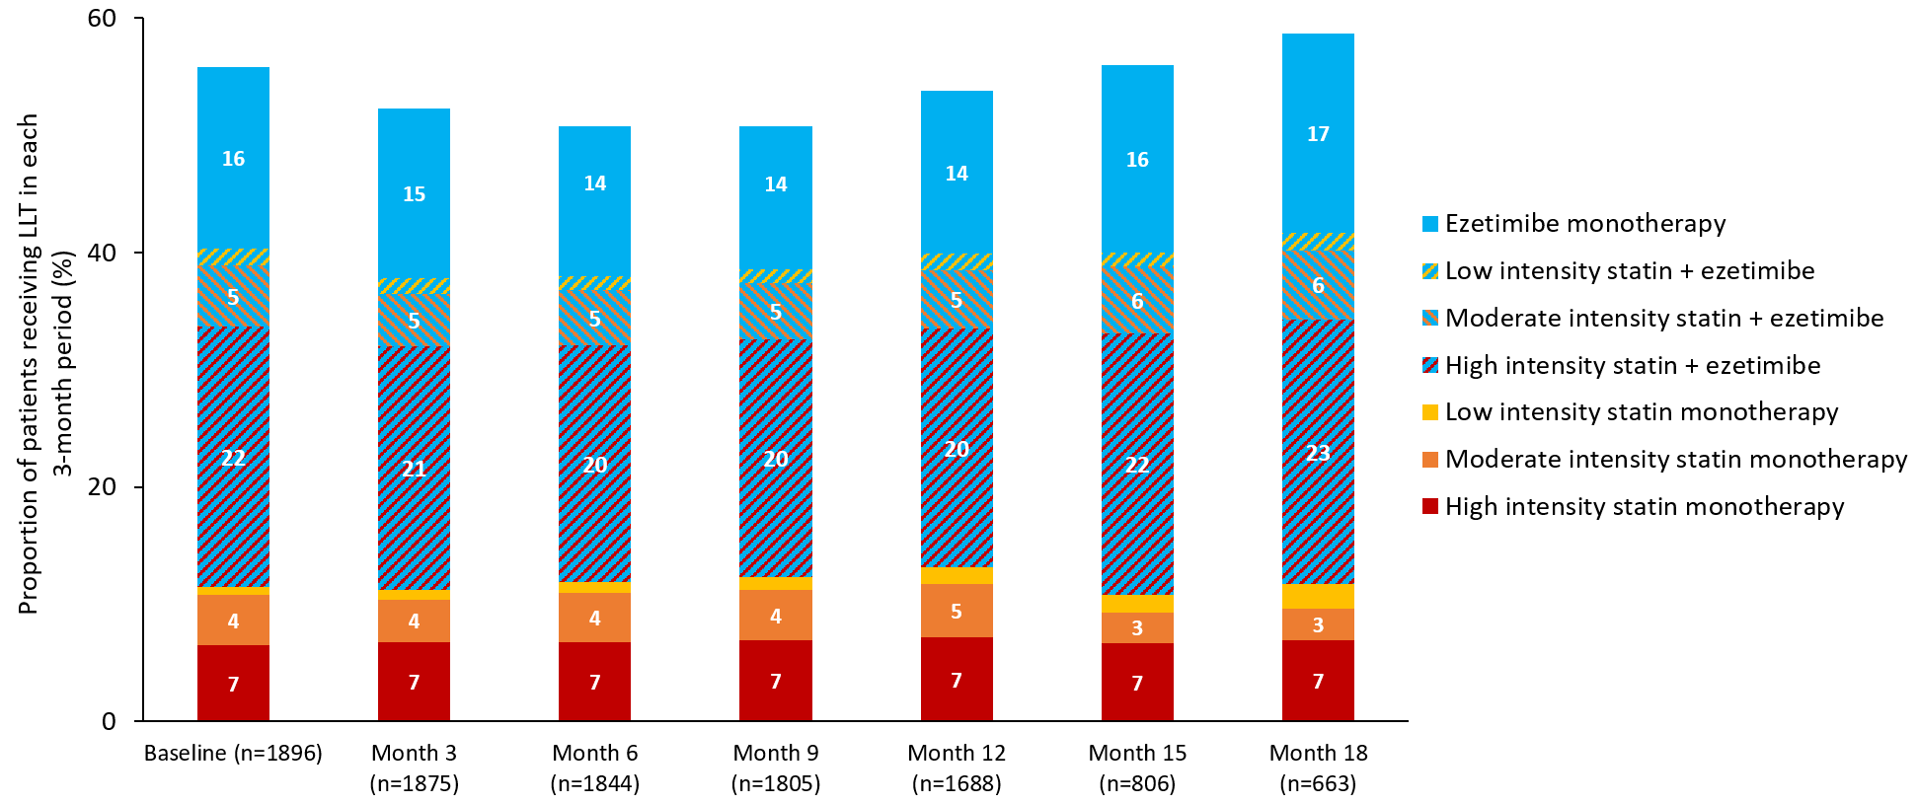
Background LLT use remained stable during evolocumab treatment
LLT, lipid lowering therapy

Slide 7
Conclusions
Median LDL-C at evolocumab initiation was 3.98 mg/dL, far above the ESC/EAS recommended thresholds of 1.8 mmol/L and 1.4 mmol/L for PCSK9i initiation in high and very high-risk patients, respectively¹, reflecting local reimbursement criteria
In this study of clinical practice, evolocumab reduced LDL-C by approximately 58% and this reduction was sustained over 12–18 months
Approximately 40% of these very high-risk patients were receiving evolocumab monotherapy and 58% achieved the 2019 ESC/EAS LDL-C goal of less than 1.4 mmol/L¹
2019 ESC/EAS goal attainment was higher among patients receiving evolocumab with background statin ± ezetimibe
Our data suggest a large gap between patients eligible for PCSK9i and those who receive them in clinical practice, and that achievement of ESC/EAS LDL-C goals is improved with combination therapy and a lower threshold for PCSK9i initiation
EAS, European Atherosclerosis Society; ESC, European Society of Cardiology; LDL-C, low-density lipoprotein cholesterol; LLT, lipid lowering therapy; PCSK9i; proprotein convertase subtilisin/kexin type 9 inhibitor. 1. Mach F, et al. Eur Heart J 2019; 41: 111-188

Slide 8


Slide 9
What Potential Risk Reduction Could Be Achieved with Evolocumab Treatment? A Simulation Based on Observational Data from a Cohort of Users in 10 European Countries

Slide 10
What Potential Risk Reduction Could Be Achieved with Evolocumab Treatment? A Simulation Based on Observational Data from a Cohort of Users in 10 European Countries
KK Ray¹, I Bridges², E Bruckert³ , B Van Hout⁴ , M Sibartie⁵, G Villa⁵
¹Imperial College London, London, UK; ²Amgen Ltd, Uxbridge, UK; ³Hôpital Pitié Salpêtrière, Paris, France; ⁴University of Sheffield, Sheffield, UK;
⁵Amgen (Europe) GmbH, Rotkreuz, Switzerland
Ray KK, et al. Poster presented at European Society of Cardiology Congress (online), 29 August–1 September 2020

Slide 11
Introduction and Purpose
The FOURIERª trial enrolled patients at very high cardiovascular (CV) risk with a mean low-density lipoprotein cholesterol (LDL-C) of 2.5 mmol/L, and demonstrated that evolocumab reduced major CV events by 1.5% in absolute terms over 2.2 years.¹
More research is necessary to further understand the potential benefits of evolocumab in a real-world setting.
Simulate baseline CV risk and assess potential CV risk reduction among a large European cohort of evolocumab users.
a.FOURIER: Further cardiovascular OUtcomes Research with PCSK9 Inhibition in subjects with Elevated Risk
1. Sabatine MS et al. Am Heart J 2016;173:94–101.
Ray KK, et al. Poster presented at European Society of Cardiology Congress (online), 29 August–1 September 2020

Slide 12
Methods
We used interim data from HEYMANS,ª an observational study of patients initiating evolocumab across 10 European countries.
Data analysed were from August 2015, with follow-up until October 2019.²
For each included patient, we:
estimated baseline 10-year CV risk, using three different methods
prediction using REduction of Atherothrombosis for Continued Health (REACH) equation³
simulation based on FOURIER trial¹
simulation based on FOURIER-like observational data⁴
calculated the absolute LDL-C reduction with evolocumab treatment
simulated the relative risk reduction (RRR), using random sampling from the probability distribution of the rate ratio per 1 mmol/L (from the key secondary endpoint in FOURIER)¹
calculated the absolute risk reduction (ARR).
a.HEYMANS: cHaractEristics of hYperlipidaeMic pAtieNts at initiation of evolocumab and treatment patterns.
1. Sabatine MS et al. Am Heart J 2016;173:94–101. 2. Ray KK et al. Oral presentation presented at the ESC Congress 2020, 29 August–1 September 2020, online. 3. Wilson PWF et al. Am J Med 2012;125:695–703.e1. 4. Lindh M et al. Eur Heart J Qual Care Clin Outcomes 2019;5:225–32.
.
Ray KK, et al. Poster presented at European Society of Cardiology Congress (online), 29 August–1 September 2020

Slide 13
Results
Our analysis included 799 patients initiating evolocumab in clinical practice as per local reimbursement criteria, with up to 18 months of follow-up.
Mean (standard deviation [SD]) baseline LDL-C was 3.8 (1.4) mmol/L, with a mean (SD) absolute reduction of 2.1 (1.2) mmol/L during evolocumab treatment.
Ray KK, et al. Poster presented at European Society of Cardiology Congress (online), 29 August–1 September 2020

Slide 14
Simulated Probability Distributions for 10-year CV Risk Before and After Evolocumab Treatment (Figure 1)
Probability distributions using the three different methods for simulating 10‑year CV risk before and after evolocumab treatment
35
REACH equation
35
FOURIER trial
35
FOURIER-like observational data
Before evolocumab treatment
30
30
30
After evolocumab treatment
Proportion of patients (%)
Proportion of patients (%)
Proportion of patients (%)
25
25
25
20
20
20
15
15
15
10
10
10
5
5
5
0
0
0
0
10
20
30
40
50
60
70
80
90
100
0
10
20
30
40
50
60
70
80
90
100
0
10
20
30
40
50
60
70
80
90
100
10-year CV risk (%)
10-year CV risk (%)
10-year CV risk (%)
CV, cardiovascular; REACH, REduction of Atherothrombosis for Continued Health.
Ray KK, et al. Poster presented at European Society of Cardiology Congress (online), 29 August–1 September 2020

Slide 15
Predicted 10-year CV Risk Before and After Evolocumab Treatment (Table 1)
Predicted 10-year CV risk, RRR and ARR
 | REACH equation² | FOURIER trial¹ | FOURIER-like observational data³
Before evolocumab treatment, %, mean (SD) | 35.7 (16.7) | 35.9 (12.1) | 41.4 (13.0)
After evolocumab treatment, %, mean (SD) | 25.3 (13.4) | 24.9 (8.2) | 29.3 (9.2)
RRR, %, mean (SD) | 33.3 (17.3) | 33.3 (17.3) | 33.3 (17.3)
ARR, %, mean (SD) | 10.4 (8.0) | 11.0 (8.1) | 12.1 (8.6)
NNT | 10 | 9 | 8
ARR, absolute risk reduction; CV, cardiovascular; NNT, number needed to treat; REACH, REduction of Atherothrombosis for Continued Health; RRR, relative risk reduction; SD, standard deviation.
1. Sabatine MS et al. Am Heart J 2016;173:94–101. 2. Wilson PWF et al. Am J Med 2012;125:695–703.e1. 3. Lindh M et al. Eur Heart J Qual Care Clin Outcomes 2019;5:225–32.
Ray KK, et al. Poster presented at European Society of Cardiology Congress (online), 29 August–1 September 2020

Slide 16
Simulated Probability Distributions for 10-year ARR (Figure 2)
35
REACH equation
FOURIER trial
30
FOURIER-like observational data
Proportion of patients (%)
Probability distributions for 10-year ARR using the three different methods for simulating 10-year CV risk
25
20
15
10
5
0
-10
-5
0
5
10
15
20
25
30
35
40
45
50
55
60
65
10-year ARR (%)
ARR, absolute risk reduction; REACH, REduction of Atherothrombosis for Continued Health.
Ray KK, et al. Poster presented at European Society of Cardiology Congress (online), 29 August–1 September 2020

Slide 17
Key Results and Conclusions
This European cohort of 799 evolocumab users had an almost two-fold higher baseline LDL-C (3.8 mmol/L) than patients enrolled in the FOURIER trial, which translated to higher baseline 10-year CV risk, ranging from 35.7% to 41.4%.
Consequently, the estimated 10-year ARR, based on efficacy results from FOURIER, was larger than observed in the trial, ranging from 10.4% to 12.1%.
Ray KK, et al. Poster presented at European Society of Cardiology Congress (online), 29 August–1 September 2020

Slide 18
Disclosures
KKR reports grants and personal fees from Aegerion, Amgen, Daiichi Sankyo, MSD, Pfizer and Sanofi/Regeneron, personal fees from AbbVie, Akcea, Algorithm, AstraZeneca, Bayer, Boehringer Ingelheim, Cerenis, Cipla, Dr Reddy’s, Esperion, Kowa, Lilly, Novartis, Silence Therapeutics, Takeda, The Medicines Company and Zuellig Pharma.
IB is an employee of Amgen Ltd.
EB reports personal fees from Aegerion, Akcea, Amgen, Danone, MSD, Mylan, Sanofi/Regeneron and Servier.
BVH receives consulting fees from Amgen.
MS and GV are employees of Amgen Europe (GmbH).
Ray KK, et al. Poster presented at European Society of Cardiology Congress (online), 29 August–1 September 2020

Slide 19
Acknowledgements
This analysis was funded by Amgen (Europe) GmbH.
Medical writing and editorial support were provided by Claire Desborough of Amgen and editorial support was also provided by Sinéad Flannery of PharmaGenesis London, London, UK.
Ray KK, et al. Poster presented at European Society of Cardiology Congress (online), 29 August–1 September 2020

